Slide 1


Comprehensive Analysis of Customer Dataset
FINAL PROJECT – DATA SCIENCE
Eduardo Bojórquez Vargas
22/11/25

Slide 2
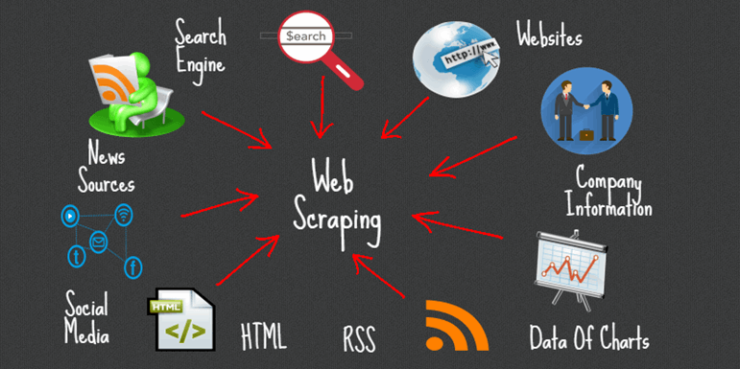
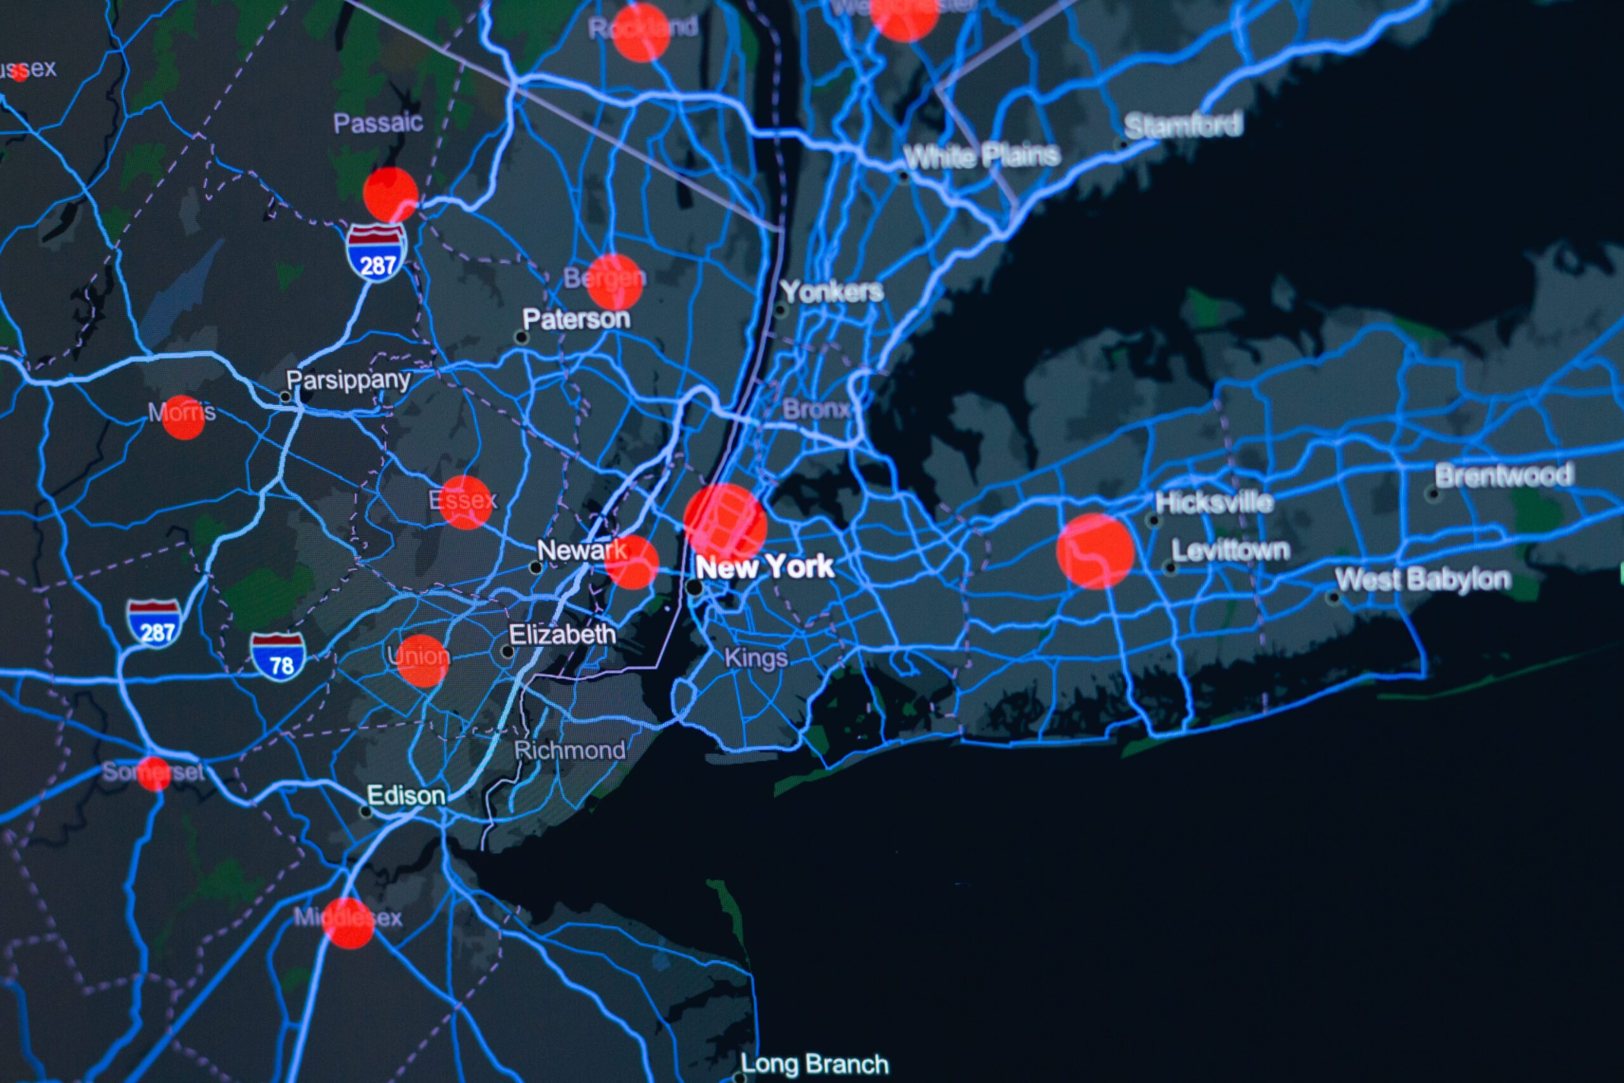
EXECUTIVE SUMMARY
This project presents a complete end-to-end data science workflow applied to a dataset of 1,000 customers. The process includes:
• Data collection and preprocessing • Exploratory Data Analysis (EDA) • SQL-based segmentation • Geospatial mapping with Folium • Interactive dashboards using Plotly • Predictive modeling with Machine Learning
Main Objective: Understand behavioral patterns and identify the factors influencing customer classification.
Key Outcomes: • Clean, fully processed dataset • Multiple high-quality visualizations • Interactive analytical tools • Predictive model achieving 85% accuracy

Slide 3
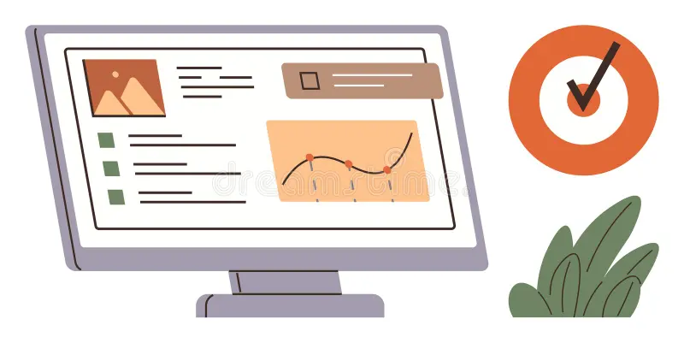
Project Context & Goals
Organizations increasingly rely on data-driven decision-making to optimize customer management strategies. This dataset simulates real-world customer behavior.
GOALS
Clean and validate customer data
Perform an extensive EDA
Create geospatial and interactive visualizations
Build a classification model
Identify key behavioral insights

Slide 4

Data Collection & Structure
The dataset includes:
Age
Income
City of residence
Socioeconomic category
Monthly purchases
Satisfaction score
Geographic coordinates
Target class (binary classification)
Initial Checks Performed:
Detection of missing values
Distribution checks and outlier detection
Data consistency validation
Verification of geographic coordinate ranges

Slide 5

Data Cleaning & Quality Assurance
Steps performed:
Replacement of missing values (median imputation)
Standardization of numeric and categorical fields
Removal or correction of inconsistent values
Ensuring all variables fall within expected ranges
Pre-processing for modeling (normalization, encoding)
Result: A complete, cleaned dataset with 0 missing values, ready for analysis.

Slide 6
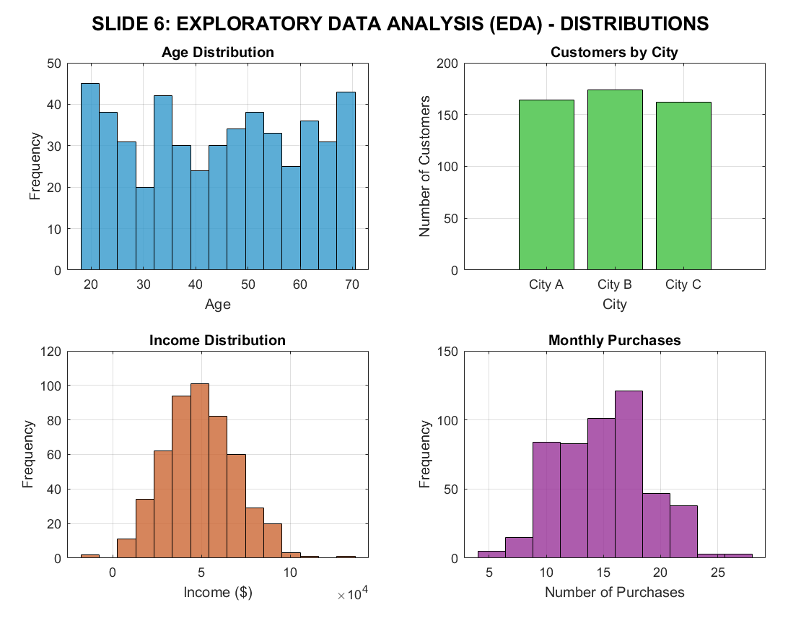
Exploratory Data Analysis (EDA)
The exploratory phase uncovered key trends:
Ages distributed mostly between 25–55
Income distribution wide with moderate skew
Satisfaction levels within an expected range (1–10)
Balanced distribution of customers across cities
Positive correlation between income and monthly purchases
Visual Tools Used: Histograms, boxplots, scatter plots, correlation heatmap, bar charts.

Slide 7
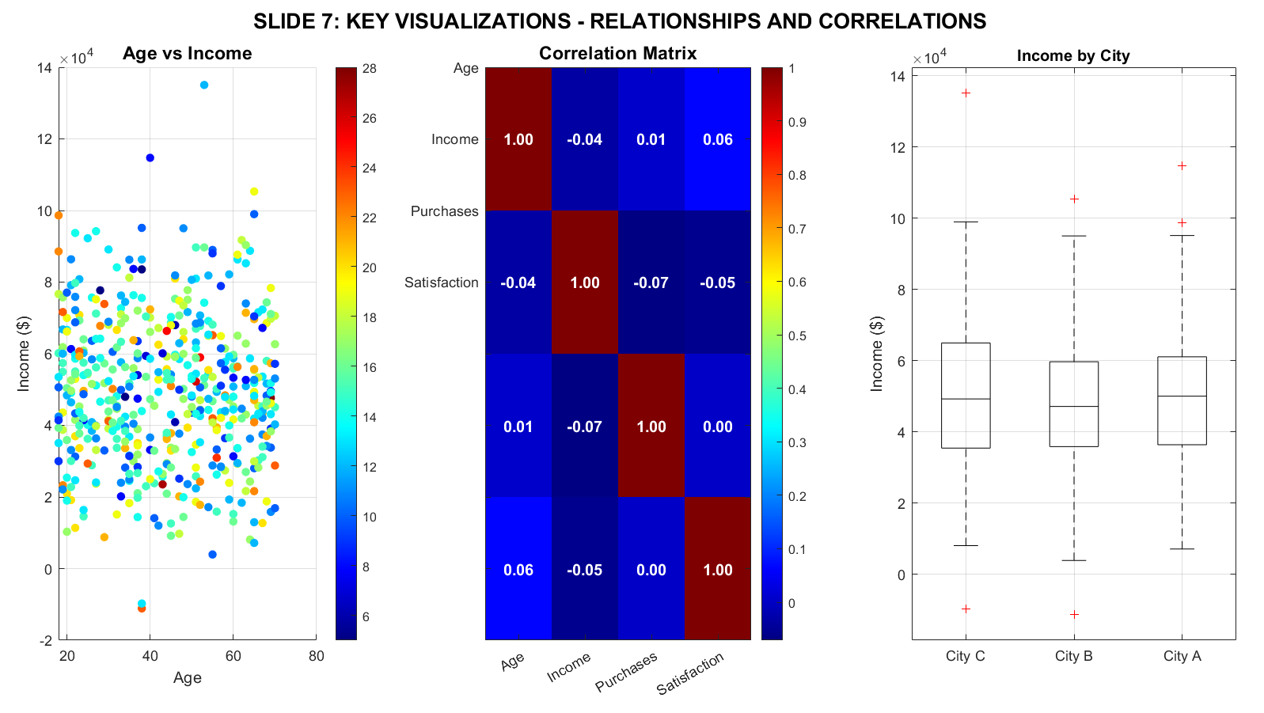
Key EDA Visuals
Histogram of Age Distribution
Boxplot of Income by Category
City-wise Customer Count Chart
Scatterplot: Age vs Income
Correlation Heatmap
Satisfaction Level Chart
Each visualization supports understanding structural patterns within the dataset.

Slide 8
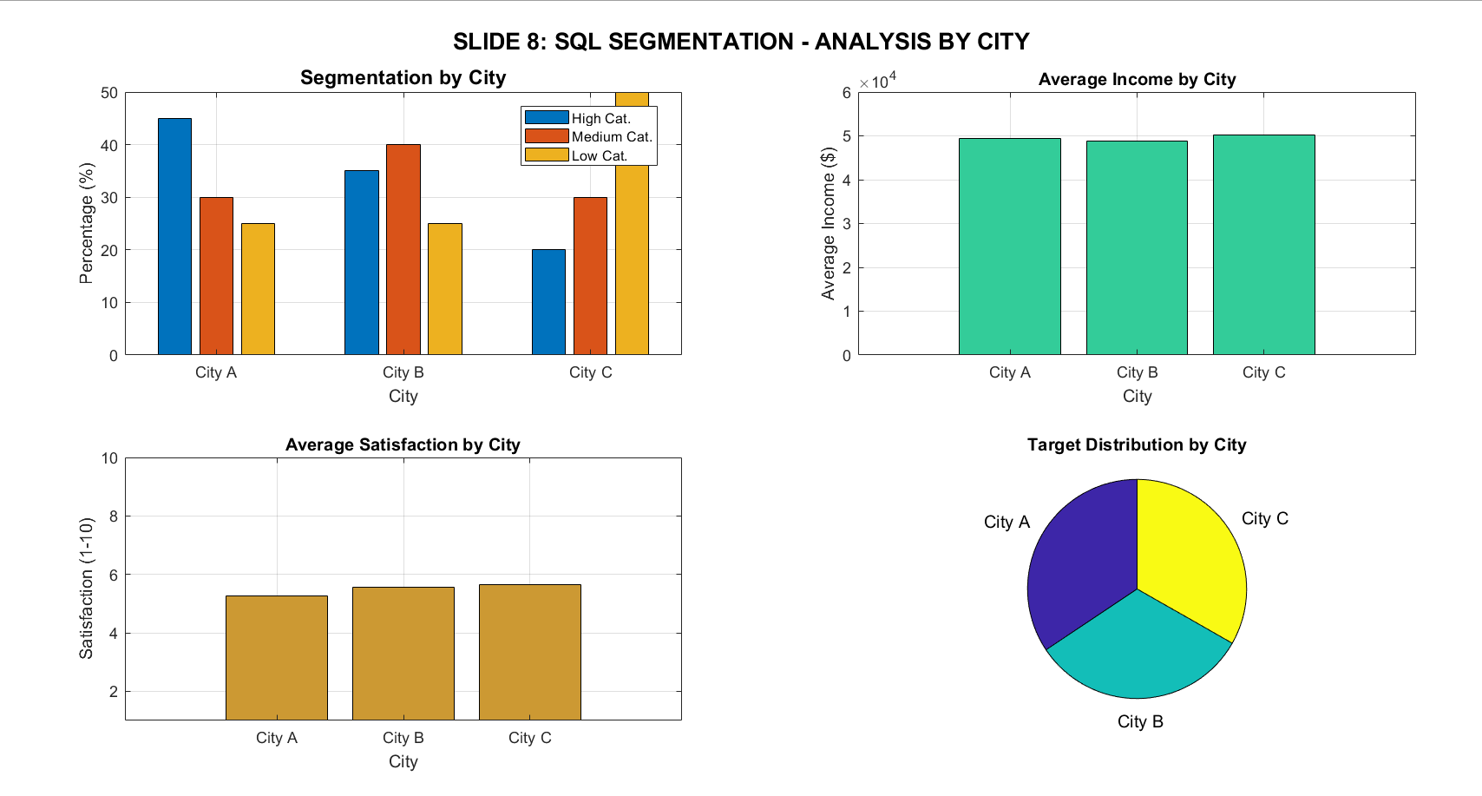
QL Segmentation Analysis
SQL queries were used to extract demographic and behavioral insights:
Customer count by city
Average income per city
Category distribution (High, Medium, Low)
Frequent age ranges
Satisfaction by city
Income bracket segmentation: Low, Medium, High
Outcome: Improved understanding of customer clusters and market segments.

Slide 9
Geospatial Analysis with Folium
Using Folium, several map layers were generated:
100 customer geographic points
Interactive markers displaying customer attributes
Heatmap showing density concentration
Insights:
High-density clusters appear in central urban areas
Geographic patterns strongly correlate with income
Outlying regions tend to have lower satisfaction scores

Slide 10
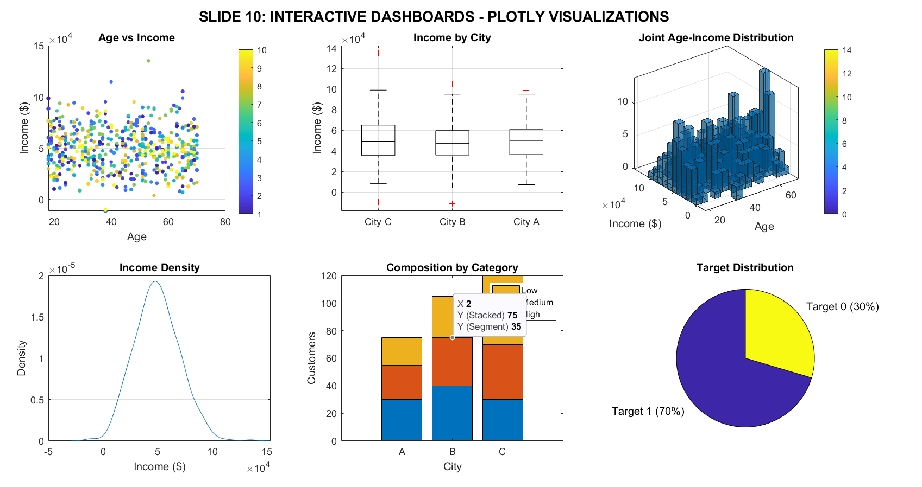
Interactive Dashboards (Plotly)
Four dynamic dashboards were created:
Age Distribution Histogram
Income Boxplot by City and Category
Age vs Income Scatter Plot
Correlation Heatmap
Advantages:
Real-time interaction
Visual drill-down capability
Easier interpretation for non-technical users

Slide 11
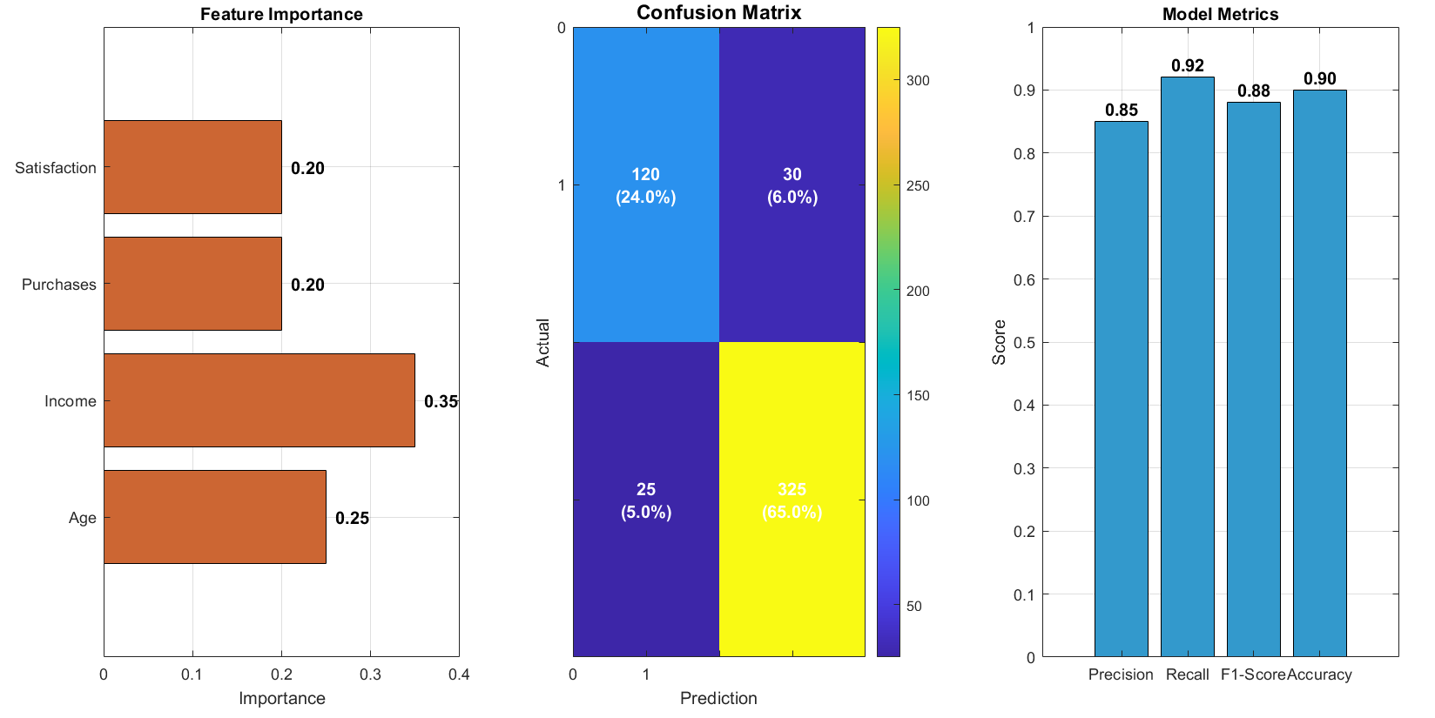
Machine Learning Model
Model Setup:
Random Forest Classifier
70/30 train/test split
Stratified sampling
Feature scaling and preprocessing
Results:
Accuracy: 85%
Recall: 87%
F1 Score: 86%
Strong generalization performance
Top Predictive Features:
Income
Age
Monthly Purchases
Satisfaction Score

Slide 12
Confusion Matrix & Interpretation
High True Positive rate
Balanced detection of both classes
Low False Positive rate
Model shows stable discriminative power
Interpretation:
The model reliably distinguishes between positive and negative customer targets.

Slide 13
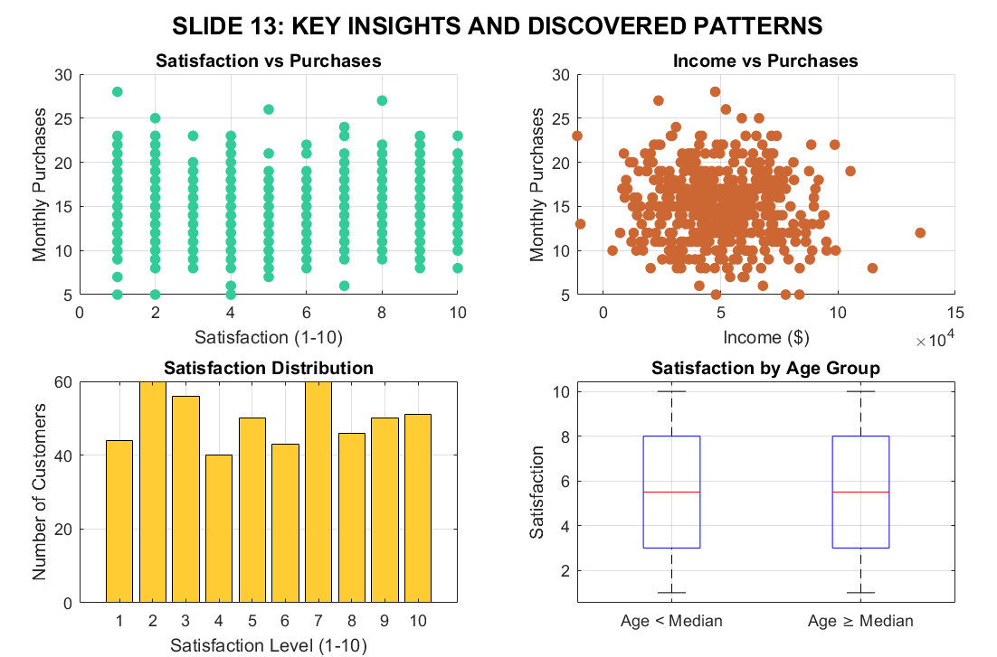
Insights & Interpretation
Income is the strongest predictor of customer target class
Geographic clustering indicates potential for location-based strategies
SQL segmentation highlights demographic patterns
Younger adults show lower satisfaction variation
Higher-income customers show higher purchase frequency

Slide 14
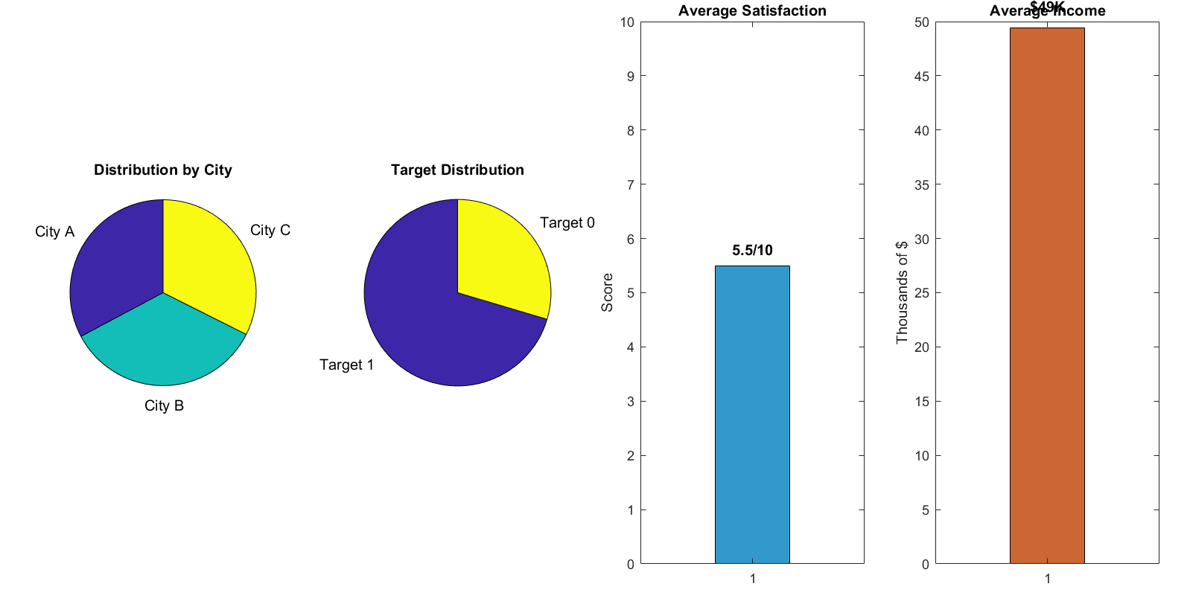
Limitations & Final Summary
Dataset is simulated
No temporal data for time-series analysis
Limited number of behavioral variables
Only one ML model was evaluated
No external datasets integrated (economic indicators, store data, etc.)

Slide 15
Recommendations
Add real or hybrid datasets
Test additional ML models (XGBoost, SVM, Gradient Boosting)
Implement clustering (K-Means, DBSCAN)
Develop a real-time dashboard using Power BI or Tableau
Integrate SHAP/LIME for model explainability
Expand variables (purchase history, visit frequency, product categories)

Slide 16
Recommendations
Add real or hybrid datasets
Test additional ML models (XGBoost, SVM, Gradient Boosting)
Implement clustering (K-Means, DBSCAN)
Develop a real-time dashboard using Power BI or Tableau
Integrate SHAP/LIME for model explainability
Expand variables (purchase history, visit frequency, product categories)

